Slide 1
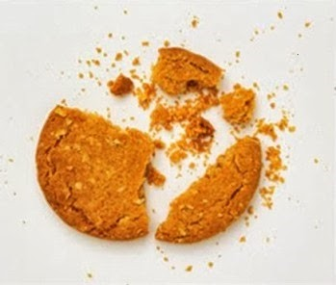

Test Automation Using Selenium
Fair Hike Academy
That’s the way the cookie crumbles!
Session 4: Selenium IDE Advanced Concepts
Mentor : Naresh Vulli, CSTE, PAHM.
fairhike@gmail.com www.fairhike.blogspot.com | www.facebook.com/fairhike

Slide 2
Today’s Topics
Recap
Base URL
Selenese Command Types
Selenium Command call
Assertion Vs Verification
Debugging
Takeaways or Exercise

Slide 3
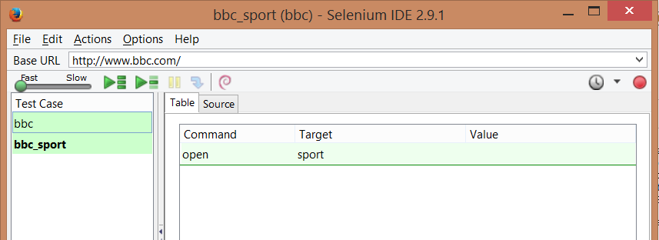
Base URL
Serves multiple tests that use same domain name, allows relative URLs data manipulation per test

Slide 4
Selenese Command Types
Actions : Changes the state of the application
Eg : Click,Select etc..
Accessors : Verifies the state of the application and store the results in variables
Eg: storeTitle, storeAttribute etc..
Assertions : Verifies that the state of the application conforms to what is expected
Eg: verifyText, verifyTitle etc..

Slide 5
Selenium Command call
command | target | value
The first column identifies the Selenium command, the second is a target, and the final column contains a value.
The second and third columns may not require values depending on the chosen Selenium command, but they should be present. Each table row represents a new Selenium command.

Slide 6
Assertion Vs Verification
When an “assert” fails, the test is aborted.
When a “verify” fails, the test will continue execution, logging the failure.
Always logically group the commands, such that each group starts with an “assert” followed by one or more “verify” test commands

Slide 7

Debugging
Breakpoint : To halt execution at a specified step
Start Point : Alternate start location for the test
Execute this Command : To ensure step level command execution is accurate

Slide 8
Takeaway or Exercise
Update selenium commands and data of test case generated using Selenium IDE
Execute script using Selenium IDE

Slide 9
Q & A

Slide 10
Thank You ☺

